Slide 1
Deep Learning
Fundamentals and math part 2
Chapter 2
Vera Hollink
2025

Slide 2
Recap Using a Neural Net for Prediction: forward propagation

Slide 3
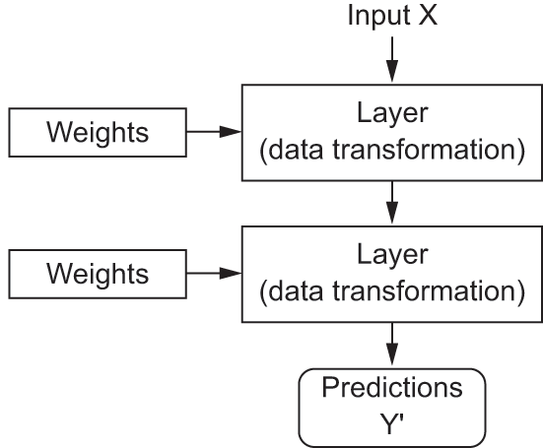
Using a NN for prediction: forward propagation

Slide 4
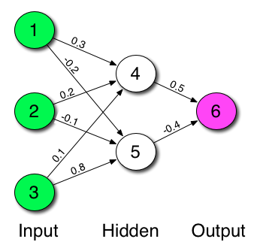
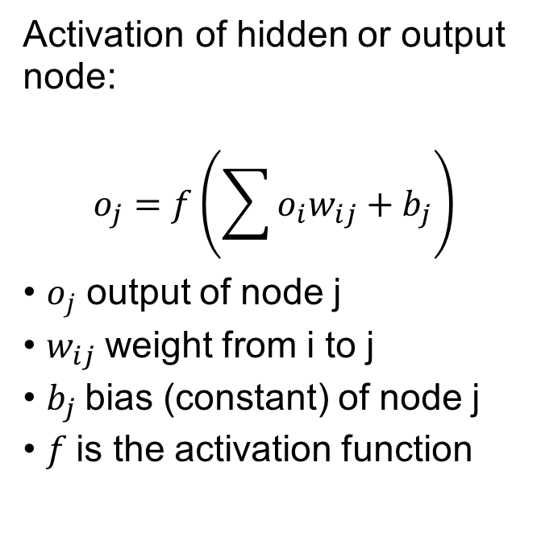
NN with hidden layer: forward propagation
Activation of hidden or output node:
$$o_{j}=f\left(\sum{o_{i}w_{ij}+b_{j}}\right)$$
$o_{j}$ output of node j
$w_{ij}$weight from i to j
$b_{j}$bias (constant) of node j
$f$is the activation function

Slide 5
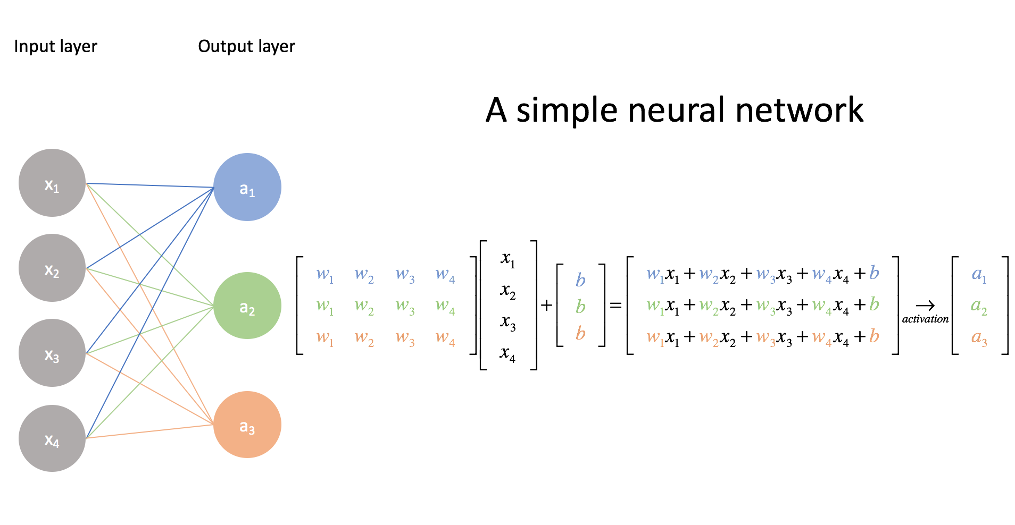
Forward propagation: matrix notation

Slide 6
Training a Neural Net: backpropagation

Slide 7
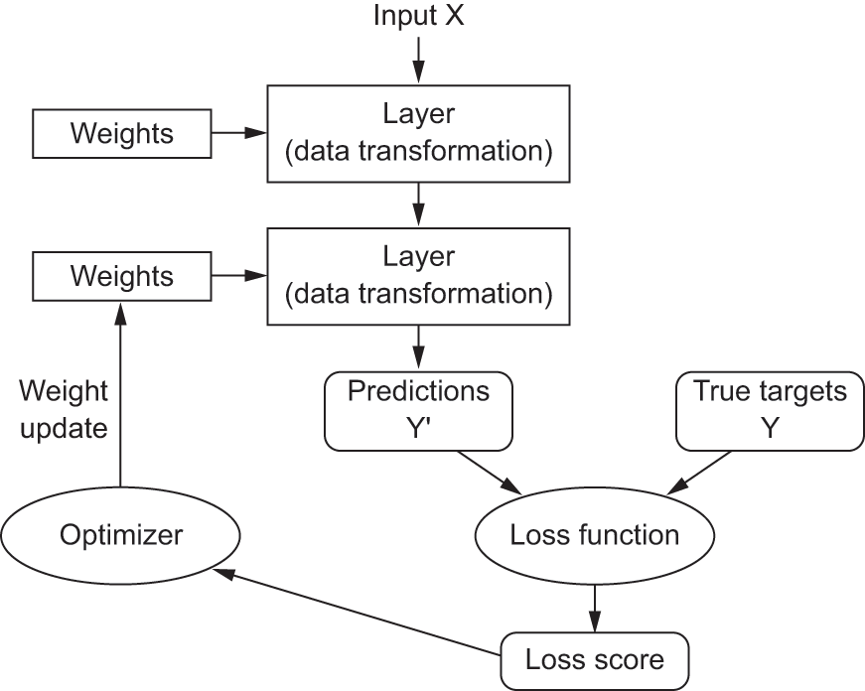
Training a NN: finding the right values for the weights

Slide 8
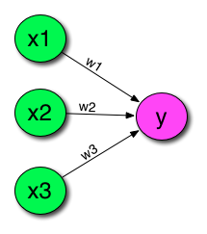
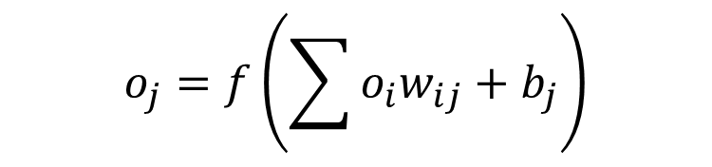
Perceptron
$$o_{j}=f\left(\sum{o_{i}w_{ij}+b_{j}}\right)$$

Slide 9
Training a perceptron
kilos | Centi-meters | Hours sleep | Class
15 | 80 | 9 | 1
9 | 63 | 10 | 1
7 | 17 | 21 | -1
6 | 25 | 17 | -1
7 | 16 | 17 | -1
Classify as dog (1) or
cat (-1)
kilos
centimeters
hours sleep per day
Intuition
Many instances: large value centimeters and too low output (cat instead of dog)
Increase weight centimeters

Slide 10
Back-propagation process
Repeat for a number of epochs:
Draw batch of training instances x with targets y
Forward propagation of x to make prediction y’
Compute the loss: mismatch between y and y’
Update all weights of the model to reduce loss on this batch
How do we do step 4?
- Try increasing and decreasing each weight? Too slow
- Solution: follow gradients

Slide 11
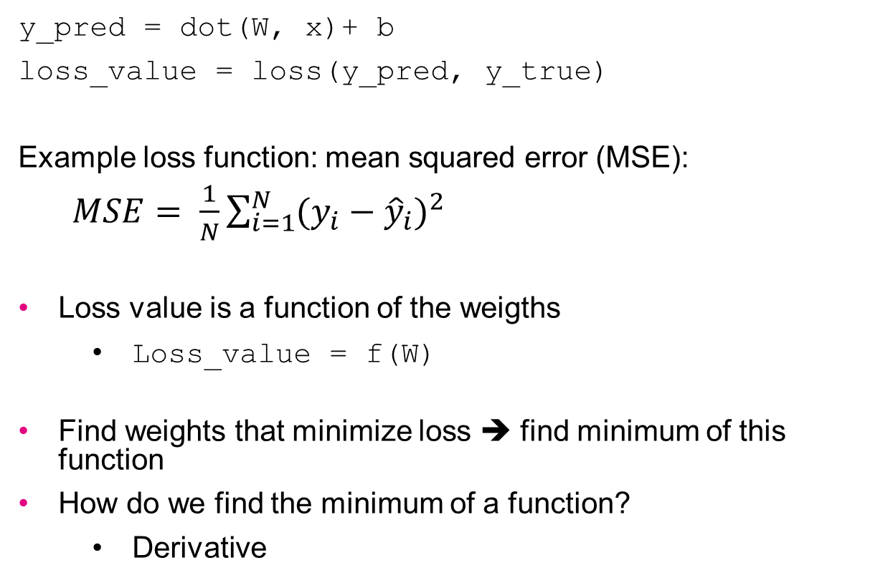
Weight gradient
y_pred = dot(W, x)+ b
loss_value = loss(y_pred, y_true)
Example loss function: mean squared error (MSE):
$MSE= \frac{1}{N}\sum_{i=1}^{N}{{(y_{i}−{\hat{y}}_{i})}^{2}}$
Loss value is a function of the weigths
Loss_value = f(W)
Find weights that minimize loss ➔ find minimum of this function
How do we find the minimum of a function?
Derivative
more loss functions in the lectures to come

Slide 12
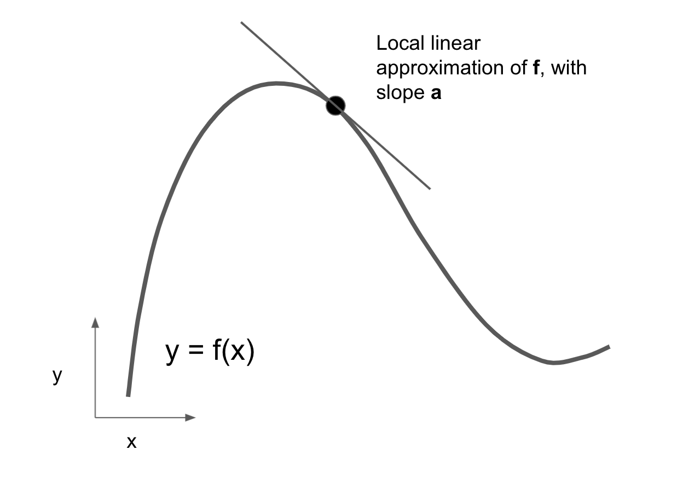
Weight gradient
Derivative of a function gives the gradient (direction)
Gradient: how much does y increase if we increase x with 1?

Slide 13
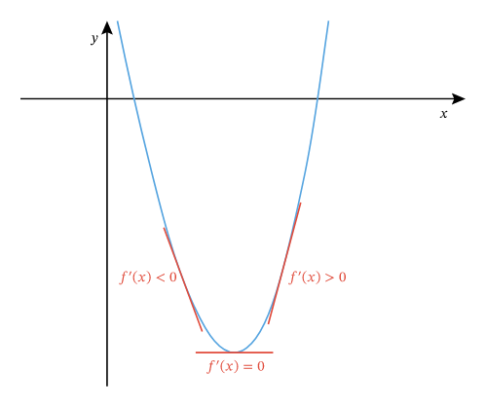
Finding the minimum by solving equation
How do we find the minimum of a function?
Loss_value = f(W)
Derivative is 0
Find W for which
F’(W) = 0
Not possible for many parameters
➔ gradient descent

Slide 14
Gradient descent
W₀ is current values of weights
Compute gradient grad(loss_value,W₀)
tensor that gives gradient of the loss with respect to each weight
For each weight: how much does the loss increase when the weight increases with 1.
Adjust weights:
W₁ = W₀ – lr * grad(loss_value,W₀)
lr is the learning rate: a hyperparameter that determines the speed of learning

Slide 15
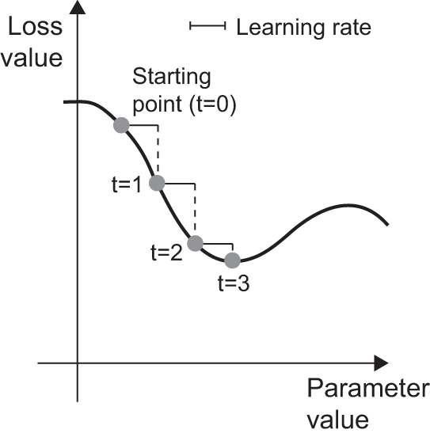
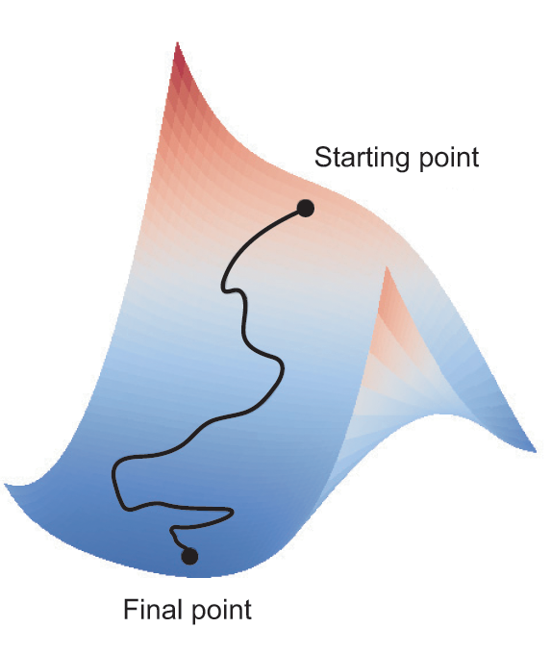
Gradient descent
One parameter
Two parameters

Slide 16
Back-propagation process
Repeat for a number of epochs:
Draw batch of training instances x with targets y
Forward propagation of x to make prediction y’
Compute the loss: mismatch between y and y’
Update all weights of the model to reduce loss on this batch
W₁ = W₀ – lr * grad(loss_value,W₀)

Slide 17

Computing the gradient The math of backpropagation

Slide 18
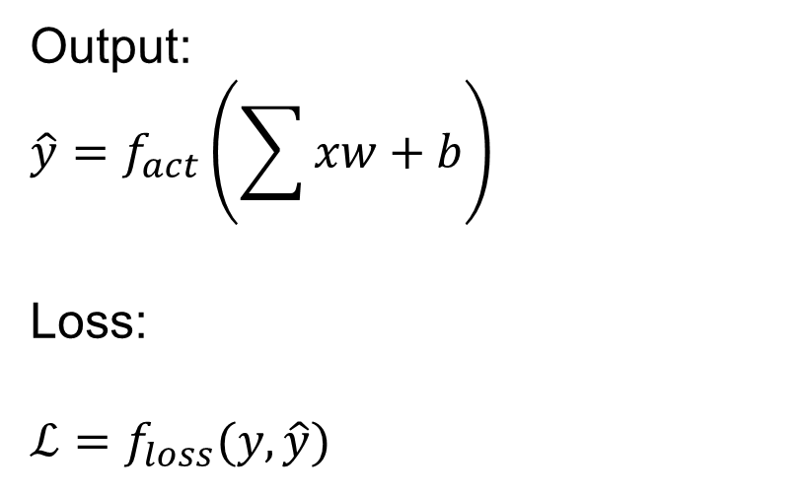
Perceptron
Output:
$$\hat{y}=f_{act}\left(\sum{xw+b}\right)$$
Loss:
$ℒ=f_{loss}(y,\hat{y})$𝑖 𝑤_𝑖𝑗+𝑏_𝑗 〗)

Slide 19
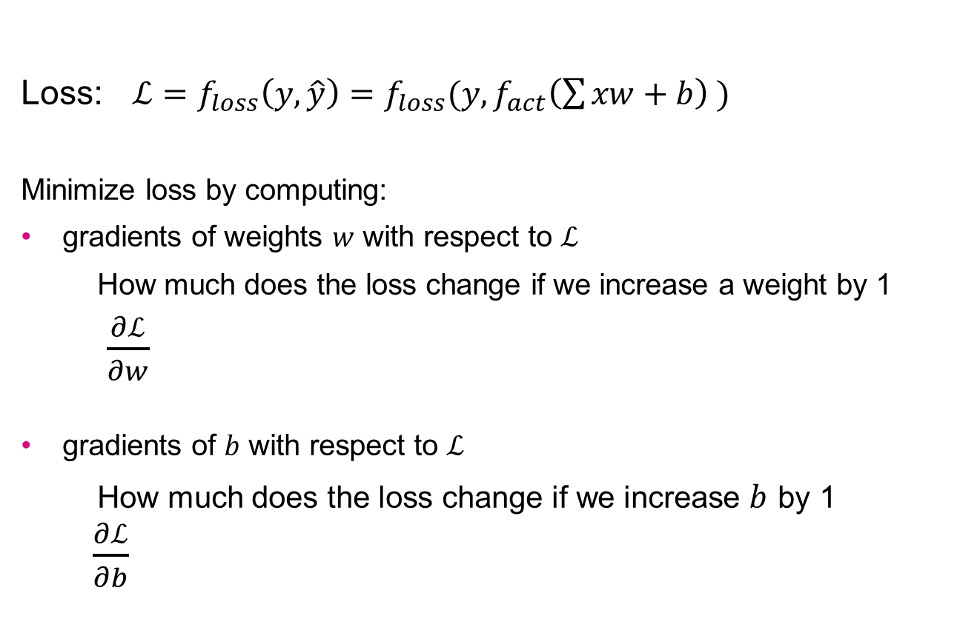
Backpropagation in a perceptron
Loss: $ℒ={f_{loss}\left(y,\hat{y}\right)=f}_{loss}(y,f_{act}\left(\sum{xw+b}\right) )$
Minimize loss by computing:
gradients of weights $w$ with respect to $ℒ$
How much does the loss change if we increase a weight by 1
$\frac{∂ℒ}{∂w}$
gradients of $b$ with respect to $ℒ$
How much does the loss change if we increase $b$ by 1
$\frac{∂ℒ}{∂b}$
Notes:
Nice explanation can be found at: https://medium.com/@ilmunabid/beginners-guide-to-finding-gradient-derivative-of-log-loss-by-hand-detailed-steps-74a6cacfe5cf

Slide 20

Backpropagation in a perceptron
$$ℒ={f_{loss}\left(y,\hat{y}\right)=f}_{loss}\left(y,f_{act}\left(\sum{xw+b}\right) \right)$$
Chain rule:
$$\frac{∂ℒ}{∂w}={f′}_{loss}\left(y,f_{act}\left(\sum{xw+b}\right) \right){f′}_{act}\left(\sum{xw+b}\right)x$$
y = f(g(x))
y’ = f’(g(x)) * g’(x)
y = f(g(h(x)))
y’ = f’(g(h(x))) * g’(h(x)) * h’(x)

Slide 21

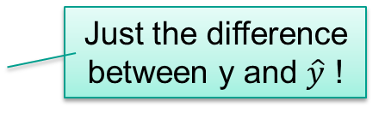
Derivative of the loss function
MSE loss
$ℒ= \frac{1}{2N}\sum_{i=1}^{N}{{(y_{i}−{\hat{y}}_{i})}^{2}}$
$\frac{∂ℒ}{∂\hat{y}}=\frac{∂\frac{1}{2N}\sum_{i=1}^{N}{{(y_{i}−{\hat{y}}_{i})}^{2}}}{∂\hat{y}}$
$=\frac{1}{2N}\sum_{i=1}^{N}{\frac{{∂(y_{i}−{\hat{y}}_{i})}^{2}}{∂{\hat{y}}_{i}}}$
$=\frac{1}{2N}\sum_{i=1}^{N}{2\left(y_{i}−{\hat{y}}_{i}\right)∗−1}$
$=−\frac{1}{N}\sum_{i=1}^{N}{(y_{i}−{\hat{y}}_{i}) }$
Dividing by 2 makes no difference but simplifies the derivative
Chain rule again
Just the difference between y and $\hat{y}$ !

Slide 22
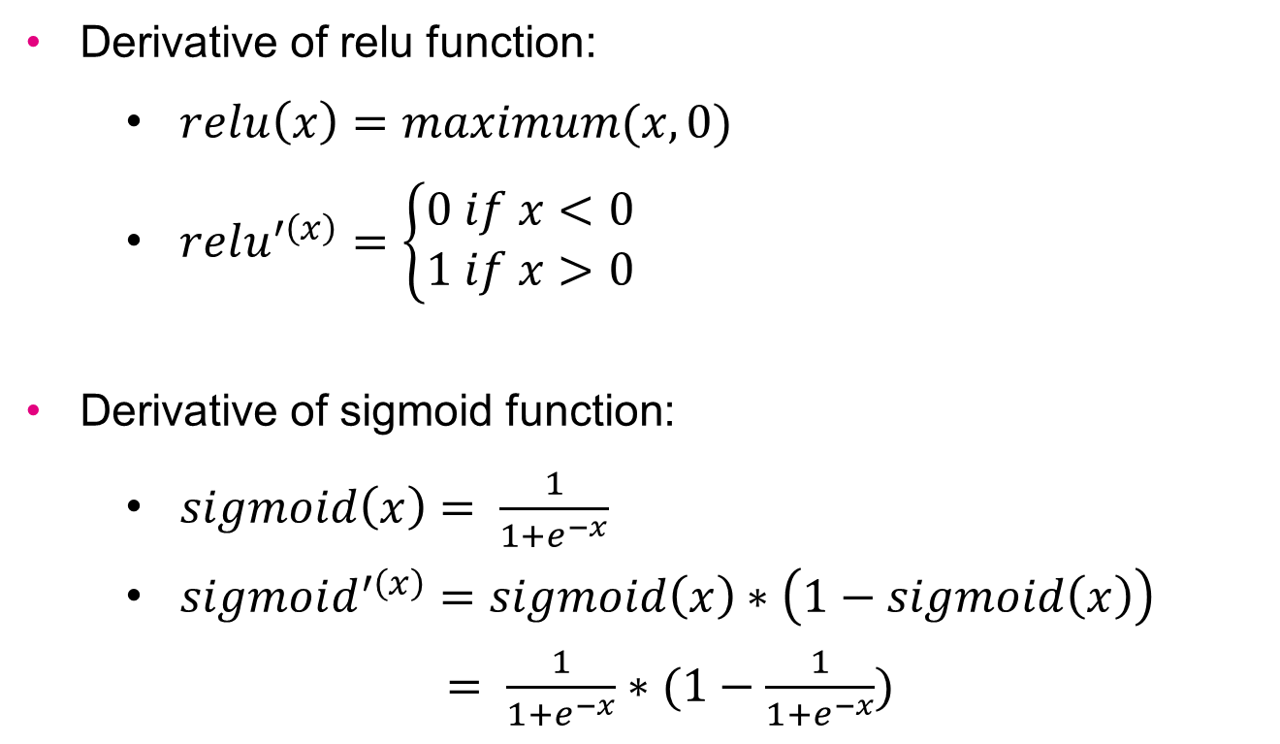
Derivative of activation functions
Derivative of relu function:
$relu\left(x\right)=maximum(x, 0)$
$relu^{′\left(x\right)}=\left\{\begin{aligned}0 if x<0 \\ 1 if x>0\end{aligned}\right.$
Derivative of sigmoid function:
$sigmoid\left(x\right)= \frac{1}{1+e^{−x}}$
$sigmoid^{′\left(x\right)}=sigmoid\left(x\right)∗\left(1−sigmoid\left(x\right)\right)$
$= \frac{1}{1+e^{−x}}∗(1−\frac{1}{1+e^{−x}})$

Slide 23
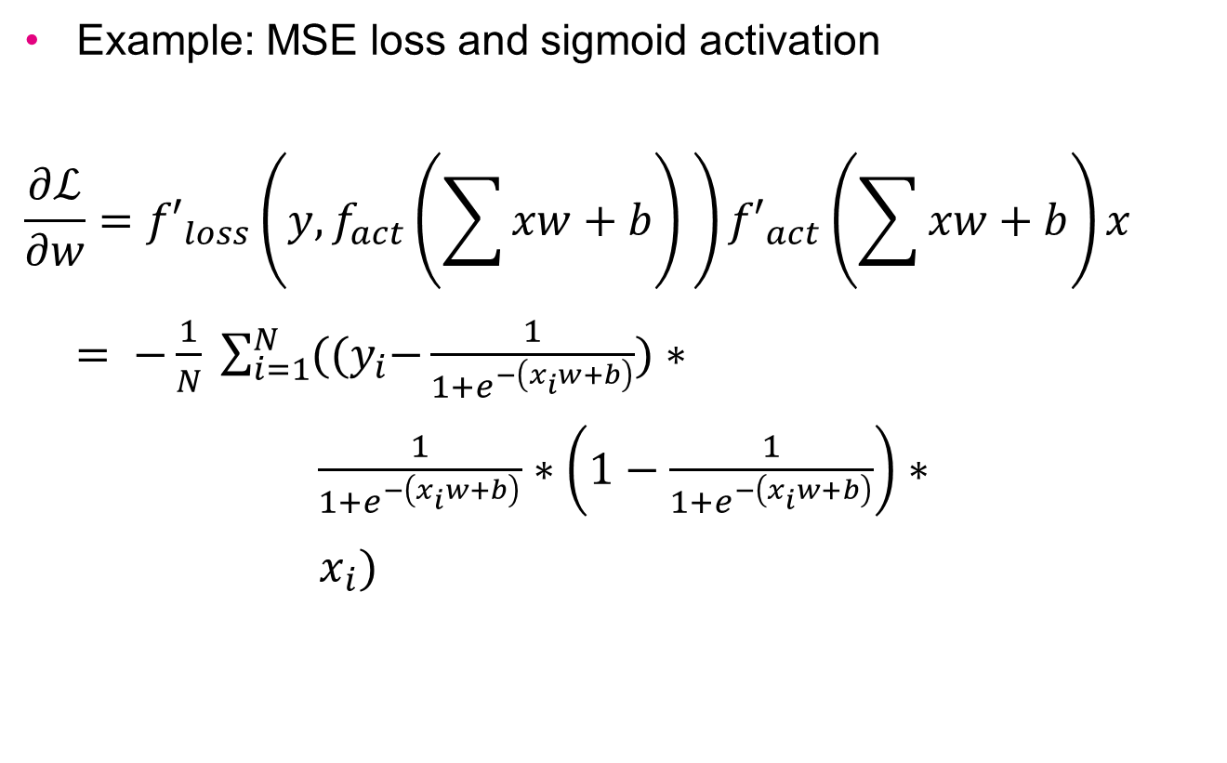

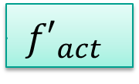
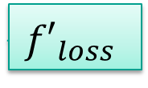

Backpropagation in a perceptron
Example: MSE loss and sigmoid activation
$$\frac{∂ℒ}{∂w}={f′}_{loss}\left(y,f_{act}\left(\sum{xw+b}\right) \right){f′}_{act}\left(\sum{xw+b}\right)x$$
$= −\frac{1}{N} \sum_{i=1}^{N}{{((y}_{i}−\frac{1}{1+e^{−\left(x_{i}w+b\right)}})}∗$
$\frac{1}{1+e^{−\left(x_{i}w+b\right)}}∗\left(1−\frac{1}{1+e^{−\left(x_{i}w+b\right)}}\right)∗$
$x_{i})$
$${(y}_{i}−\frac{1}{1+e^{−\left(x_{i}w+b\right)}})$$
$${f′}_{loss}$$
$${f′}_{act}$$
$$\text{∑}\text{(}\text{xw}\text{+}\text{b}\text{)}’$$

Slide 24

Backpropagation in a perceptron
Loss: $ℒ={f_{loss}\left(y,\hat{y}\right)=f}_{loss}(y,f_{act}\left(\sum{xw+b}\right) )$
Minimize loss by computing:
gradients of weights $w$ with respect to $ℒ$
How much does the loss change if we increase a weight by 1
$\frac{∂ℒ}{∂w}$
gradients of $b$ with respect to $ℒ$
How much does the loss change if we increase a weight by 1
$\frac{∂ℒ}{∂b}$
Notes:
Nice explanation can be found at: https://medium.com/@ilmunabid/beginners-guide-to-finding-gradient-derivative-of-log-loss-by-hand-detailed-steps-74a6cacfe5cf

Slide 25
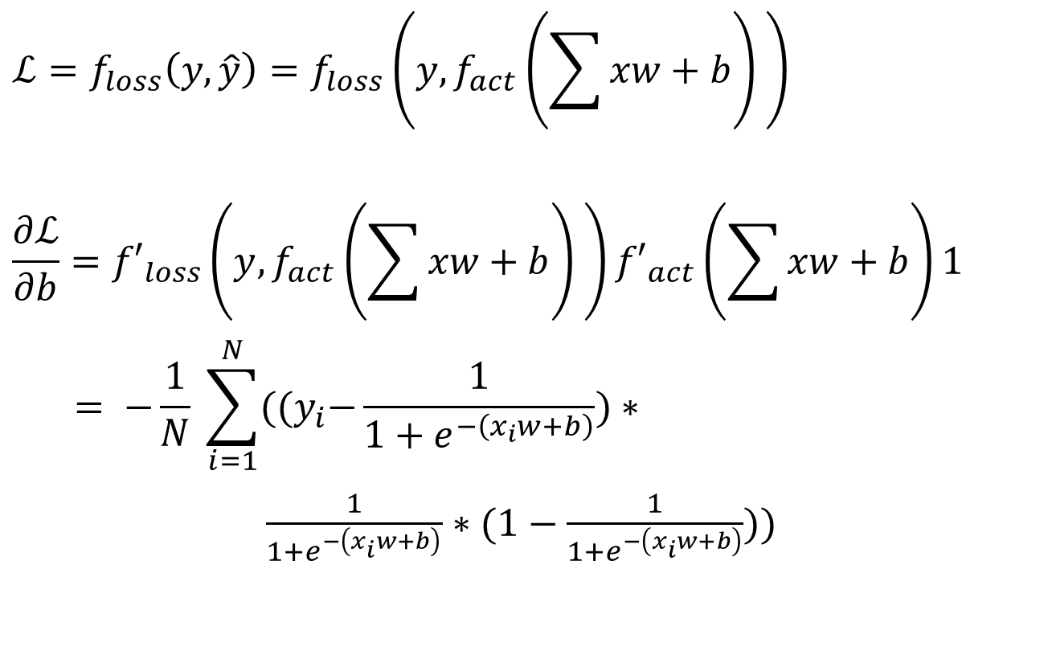
Backpropagation in a perceptron
$$ℒ={f_{loss}\left(y,\hat{y}\right)=f}_{loss}\left(y,f_{act}\left(\sum{xw+b}\right) \right)$$
$$\frac{∂ℒ}{∂b}={f′}_{loss}\left(y,f_{act}\left(\sum{xw+b}\right) \right){f′}_{act}\left(\sum{xw+b}\right)1$$
$$= −\frac{1}{N} \sum_{i=1}^{N}{{((y}_{i}−\frac{1}{1+e^{−\left(x_{i}w+b\right)}})}∗$$
$\frac{1}{1+e^{−\left(x_{i}w+b\right)}}∗(1−\frac{1}{1+e^{−\left(x_{i}w+b\right)}}))$

Slide 26
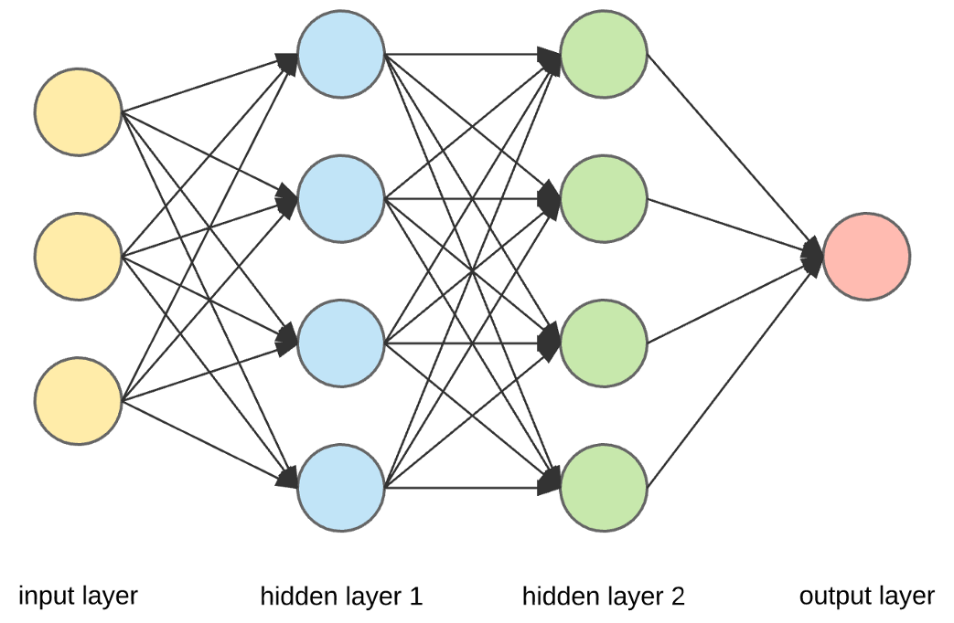
NN with hidden layers
Network has multiple layers, e.g.
Layer 1: relu
Layer 2: relu
Layer 3: sigmoid
Chain of operations:
sigmoid(W3 ∙
relu(W2 ∙
relu(W1∙inputs + b1)
+ b2)
+ b3)

Slide 27
Chaining operations: derivative
Chain rule:
y = f(g(x))
y’ = f’(g(x)) * g’(x)
Gradients: work from outside to inside
First compute grads of outer function
Then grads of inner function
Gradients of NN: right to left
First compute grads of last layer
Then grads of one but last layer
Etc.

Slide 28
Chaining operations: derivative
sigmoid(W3∙ relu(W2∙relu(W1∙inputs+b1)+b2)+ b3)
Gradients layer 3 with respect to loss_value grad(loss_value, weights_layer_3)
Gradients layer 2 with respect to loss_value grad(loss_value, weights_layer_3) * grad(output_layer_3, weights_layer_2)
Gradients layer 1 with respect to loss_value grad(loss_value, weights_layer_3) * grad(output_layer_3, weights_layer_2) * grad(output_layer_2, weights_layer_1)
How does the loss change if we change W3 and b3
How does the loss change if we change W2 and b2
How does the loss change if we change W1 and b1

Slide 29
Back-propagation process
Repeat for a number of epochs:
Draw batch of training instances x with targets y
Forward propagation of x to make prediction y’
Compute the loss: mismatch between y and y’
Update all weights of the model to reduce loss on this batch

Slide 30
Back-propagation process step 4
Update all weights of the model to reduce loss on this batch
Layer n
compute grads from loss and output of layer n
update weights
Layer n-1
compute grads from grads of layer n and output of layer n-1
update weights
…
Layer 1
compute grads from grads of layer 2 and output of layer 1
update weights

Slide 31
Summary
Forward propagation is used to make a prediction for an input
Backpropagation is used to find the optimal weights
Optimal weights are weights that minimize loss
Loss is mismatch between predicted and actual value
Backpropagation uses gradient descent:
Compute gradient of weigths with respect to loss
Update weights towards less loss
Backpropagation uses the chain rule:
Update weights from last layer to first layer

Slide 32
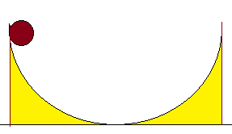
Adding momentum

Slide 33
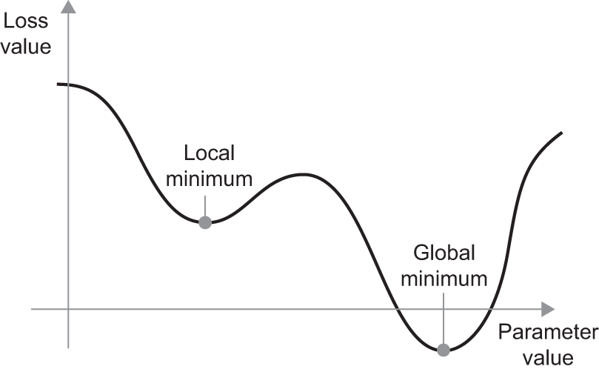
Global and local minima
The learning algorithm can get stuck in a local minimum

Slide 34
Avoiding local minima with momentum
Solution: momentum
Compute velocity: speed (and direction) of previous step
Continue a little bit in previous direction
W₁ = W₀ – lr * grad(loss_value,W₀) + momentum * velocity
momentum is a hyperparameter that determines the how strongly the previous velocity counts

Slide 35
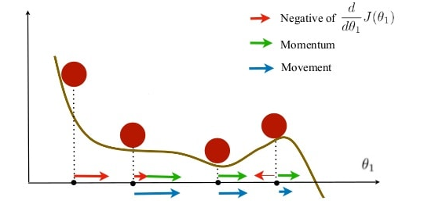
Avoiding local minima with momentum

Slide 36

Test your understanding!

